Slide 1
Science of Living System
BS20001
Arindam Mondal
School of Bioscience
Email: arindam.mondal@iitkgp.ac.in
Tel: 03222-260516

Slide 2
Why study Living System?

Slide 3
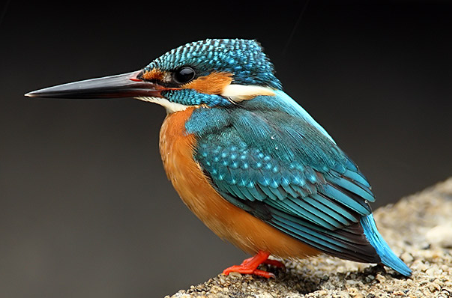
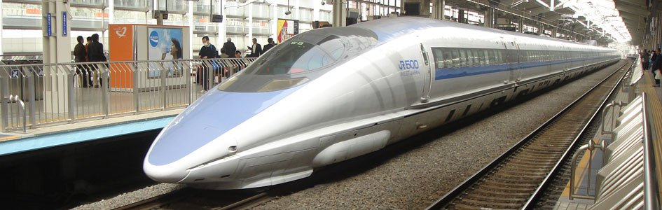
Shinkansen Bullet Train in Japan: inspired by shape of Kingfisher head
Eiji Nakatsu
Notes:
Shinkansen Bullet Train
High-speed trains can literally cause headaches. That's why Japan limits their acceptable noise-pollution level, which can be particularly high when the trains emerge from tunnels. As they drive through, air pressure builds up in waves and, when the nose emerges, can produce a shotgun-like thunderclap heard for a quarter mile. Eiji Nakatsu, a bird-watching engineer at the Japanese rail company JR-West, in the 1990s took inspiration from the kingfisher, a fish-eating fowl that creates barely a ripple when it darts into water in search of a meal. The train’s redesigned nose — a 50-foot-long steel kingfisher beak — didn't just solve the noise problem; it reduced power use and enabled faster speeds.
Photographers: Hiromi Okano/Corbis; West Japan Railway Co. Via Bloomberg

Slide 4
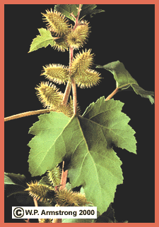
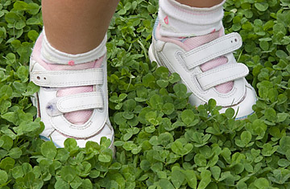
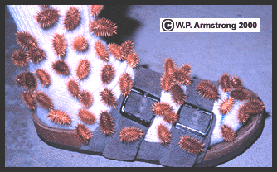
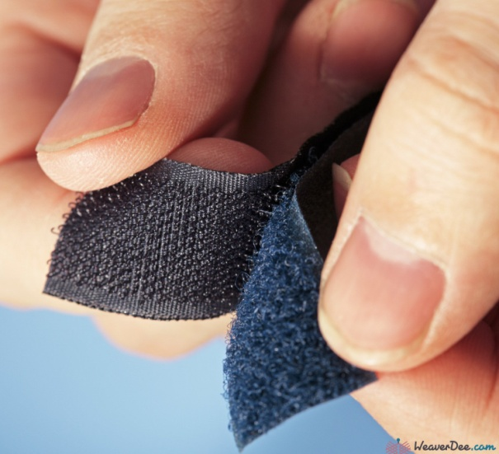
Invention of Velcro®: inspired by Cockleburs
Cockleburs
George de Mestral invented Velcro®: Unique, two-sided fastener, one side with stiff hooks like the burs and the other side with soft loops like the fabric. a combination of the words velour and crochet.
Notes:
One day in 1948, an amateur Swiss mountaineer and naturalist, George de Mestral, went on a nature walk with his dog through a field of hitchhiking bur plants. He and his dog returned home covered with burs. With an intense curiosity, Mestral went to his microscope and inspected one of the many burs stuck to his pants. He saw numerous small hooks that enabled the seed-bearing bur to cling so tenaciously to the tiny loops in the fabric of his pants. George de Mestral raised his head from the microscope and smiled thinking, "I will design a unique, two-sided fastener, one side with stiff hooks like the burs and the other side with soft loops like the fabric of my pants. I will call my invention Velcro® a combination of the words velour and crochet. It will rival the zipper in it's ability to fasten."

Slide 5
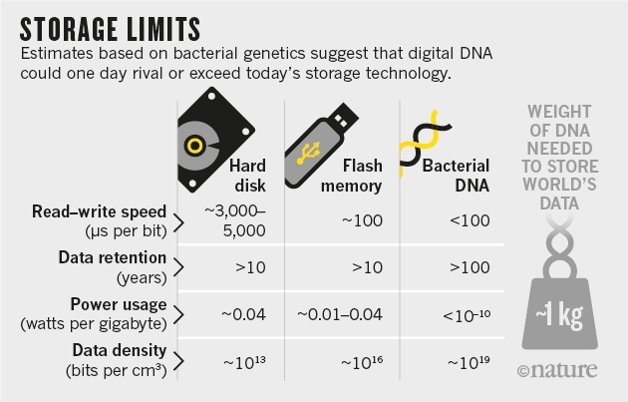
Why study Living System?

Slide 6
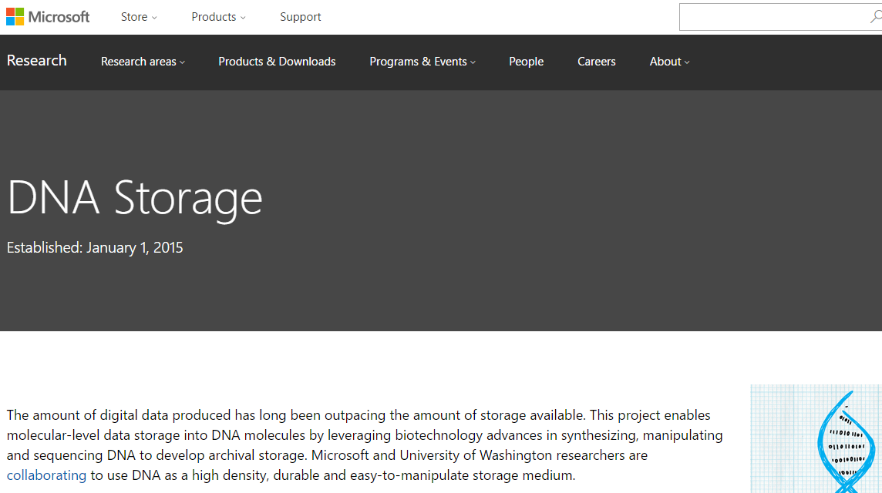
Microsoft Corporation – DNA Storage Research
A DNA-Based Archival Storage System Bornholt J, et. al. ASPLOS 2016 (International Conference on Architectural Support for Programming Languages and Operating Systems)

Slide 7
Microsoft collaborated with the University of Washington to demonstrate fully automated DNA data storage

Slide 8
What are the characteristics of a Living System?
High degree of complexity
Mechanisms for sensing and responding to alterations in surroundings
Systems for extracting, transforming and using energy from the environment
Ability to adapt and evolve
Ability to develop and grow
Capacity for precise self-replication and self-assembly, known as reproduction

Slide 9
Components of Living Systems C-H-O-N-S-P
All life forms on Earth are composed of building blocks that are made of combinations of Carbon and other elements:
Hydrogen
Oxygen
Nitrogen
Sulphur
Phosphorus

Slide 10
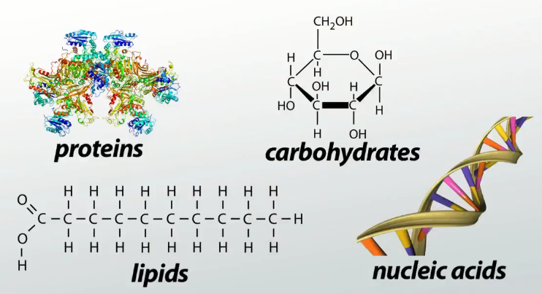
Molecules of Living Systems: Biological Macromolecules

Slide 11
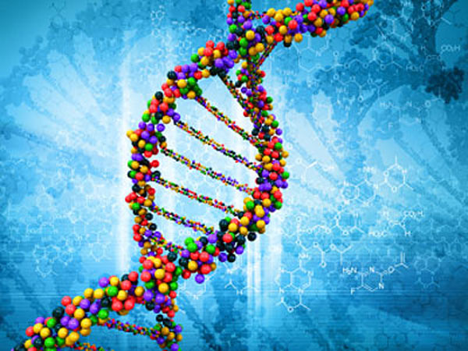
Nucleic Acid

Slide 12
Nucleic Acid
RNA: Ribonucleic Acid
DNA: Deoxyribonucleic Acid

Slide 13
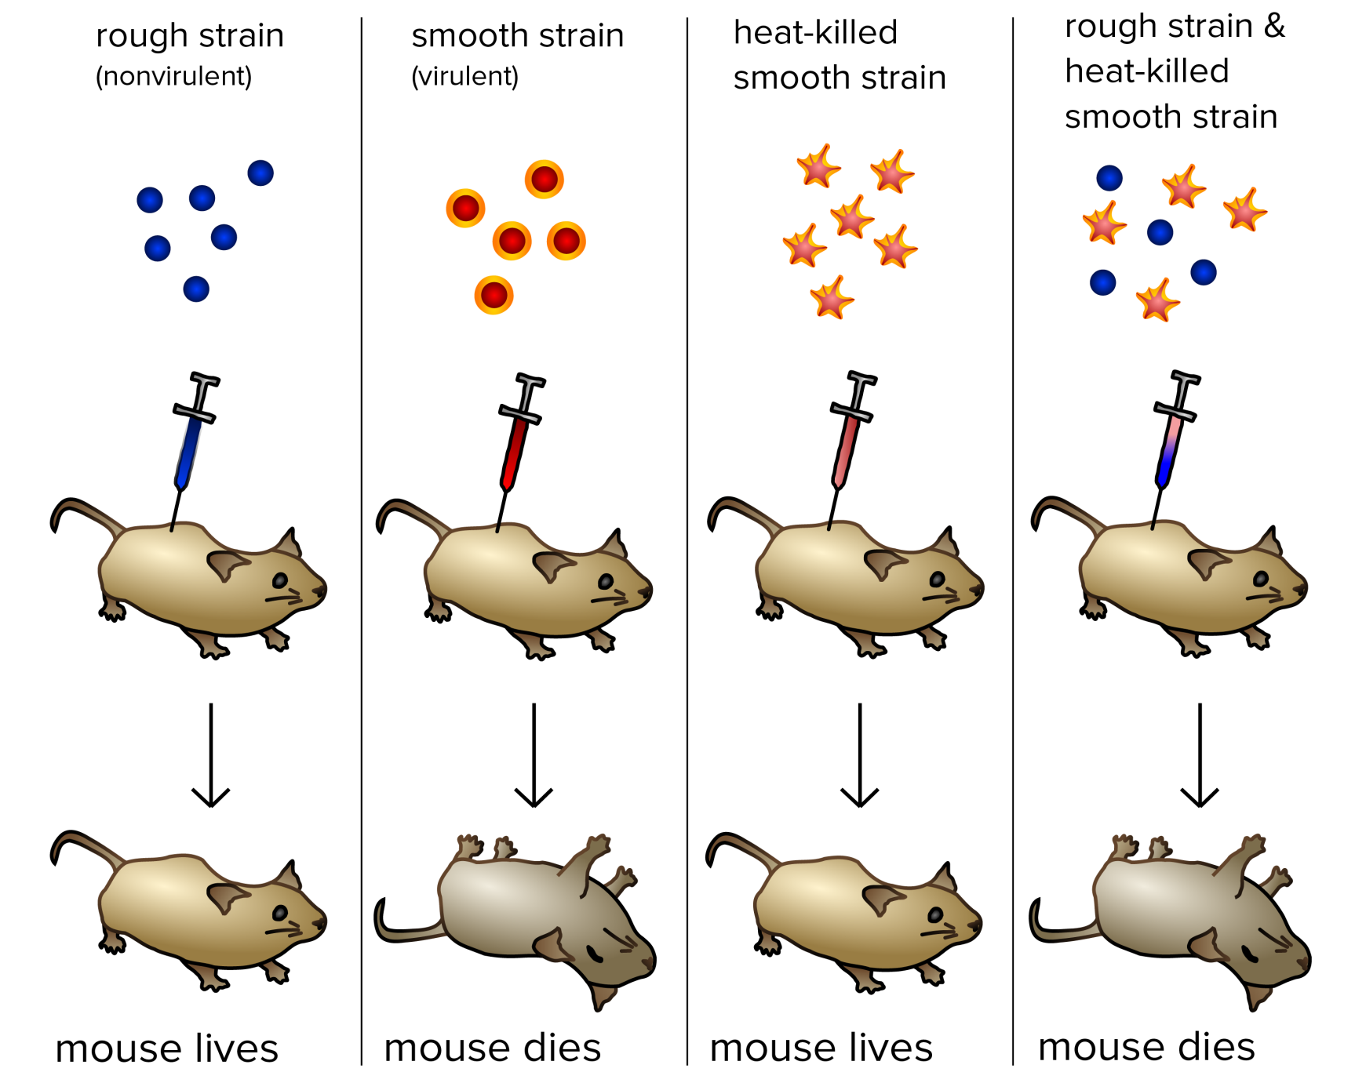
Experiment that Proves DNA is Our Genetic Material
Frederick Griffith’s experiment with bacteria (Streptococcus pneumoniae) (1928).
Notes:
Griffith's experiment, reported in 1928 by Frederick Griffith. Griffith's findings were followed by research in the late 1930s and early 40s that isolated DNA as the material that communicated this genetic information.
Frederick Griffith was a British bacteriologist whose focus was the epidemiology and pathology of bacterial pneumonia. Pneumonia was a serious cause of death in the wake of the post-WWI Spanish influenza pandemic, and Griffith was studying the possibility of creating a vaccine.
This discovery was followed by the famous Avery, MacLeod and McCarty’s 1944 experiment to show that genetic material is DNA. They digested transforming extract with DNase to show loss of transforming ability. And when they just purified DNA from the extract, that successfully transformed non-virulent bacteria into virulent form.

Slide 14
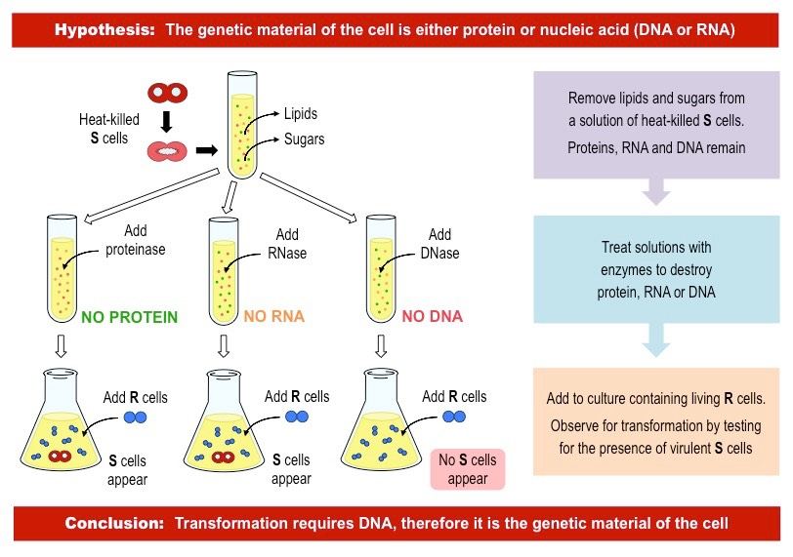
Experiment that Proves DNA is Our Genetic Material
Avery, MacLeod and McCarty’s 1944

Slide 15
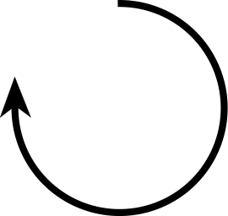
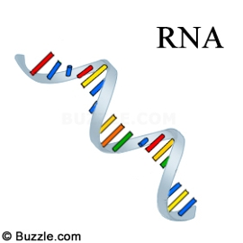
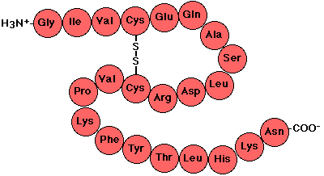
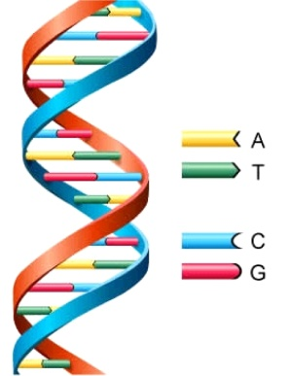
Flow of Genetic Information:
The Central Dogma of Molecular Biology
DNA Polymerase
RNA Polymerase
Ribosome
DNA
RNA
Protein
Transcription
Translation
Replication
DNA
RNA
Protein
Polymer of nucleotides
Polymer of nucleotides
Polymer of amino acids
Notes:
The central dogma of life was proposed by Francis Crick ca 1956. Here the arrows indicate the direction of transfer of genetic information. The circular arrow on DNA refers to the fact that DNA is the template for its self-replication. This is carried out by the enzyme DNA polymerase. DNA also serves as the template for RNA synthesis during transcription and this is catalyzed by the enzyme RNA polymerase. Finally, the information encoded on RNA (messenger RNA to be precise) is used to synthesize proteins by ribosomes. DNA, RNA and proteins are all polymers. The monomeric unit for DNA and RNA are called nucleotides whereas for proteins they are amino acids.

Slide 16
Nucleic Acid
Nucleic acids are polymers
Monomer---nucleotides
Nitrogenous bases
Purines
Pyrimidines
Sugar
Ribose
Deoxyribose
Phosphates
Nucleosides
Nucleotides
Notes:
Nucleic acids (DNA and RNA) are polymers. The monomeric units are called nucleotides, which have three components: nitrogenous bases, sugar and phosphate.

Slide 17
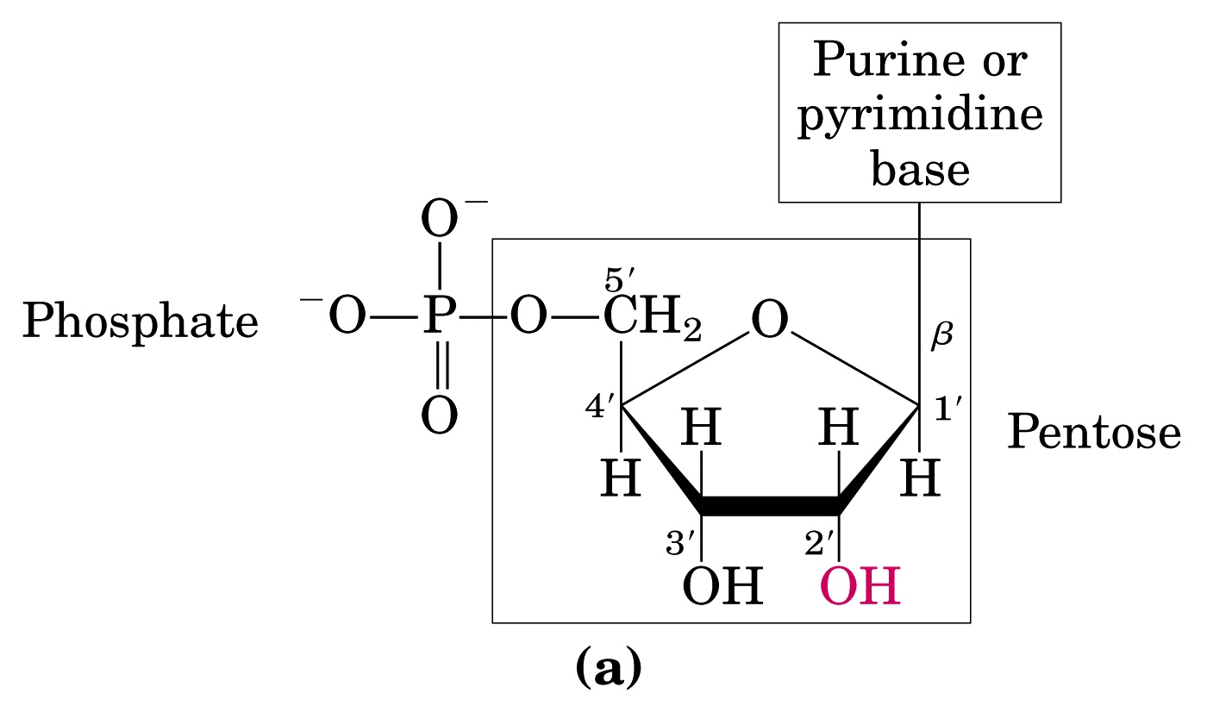
RNA vs DNA – Sugar
RNA - Ribonucleic Acid
DNA - Deoxyribonucleic Acid
(OH)
(H)
N-β-glycosyl bond
(Ribose)
Ester Bond
Notes:
The sugar has five carbons and has the common name Pentose. The numbering of the carbon atoms are shown (important!) and are followed by the symbol prime (‘) to distinguish them from the numbered atoms on the nitrogenous bases. Nucleic acids have two kinds of pentoses: ribose and deoxyribose. The difference occurs at the 2’ position that has OH group in ribose sugar and H in deoxyribose sugar. The nitrogenous base (purine or pyrimidine) is covalently linked to the pentose sugar at 1’ carbon and the phosphate group is linked by an ester bond at the 5’ carbon.

Slide 18
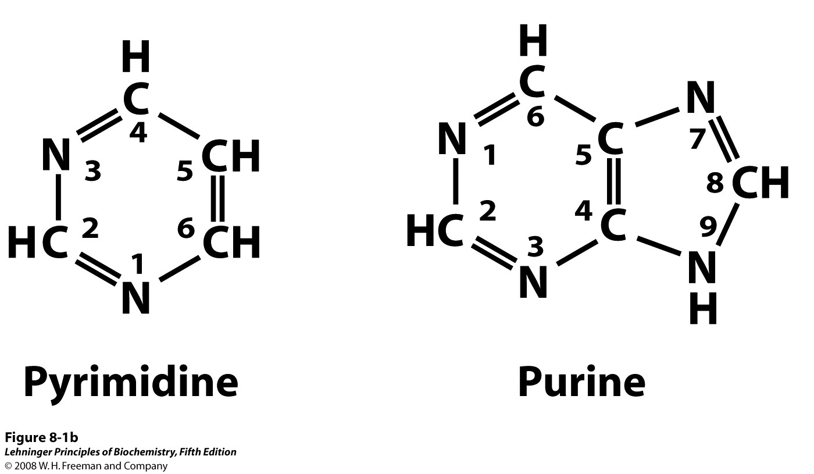
Two Types of Nitrogenous Bases
Notes:
The nitrogenous bases are of two types: purine and pyrimidine. The numbering conventions are shown. The N-1 of pyrimidine and N-9 of purine are covalently linked to the 1’ carbon of the pentose sugar in DNA and RNA.

Slide 19
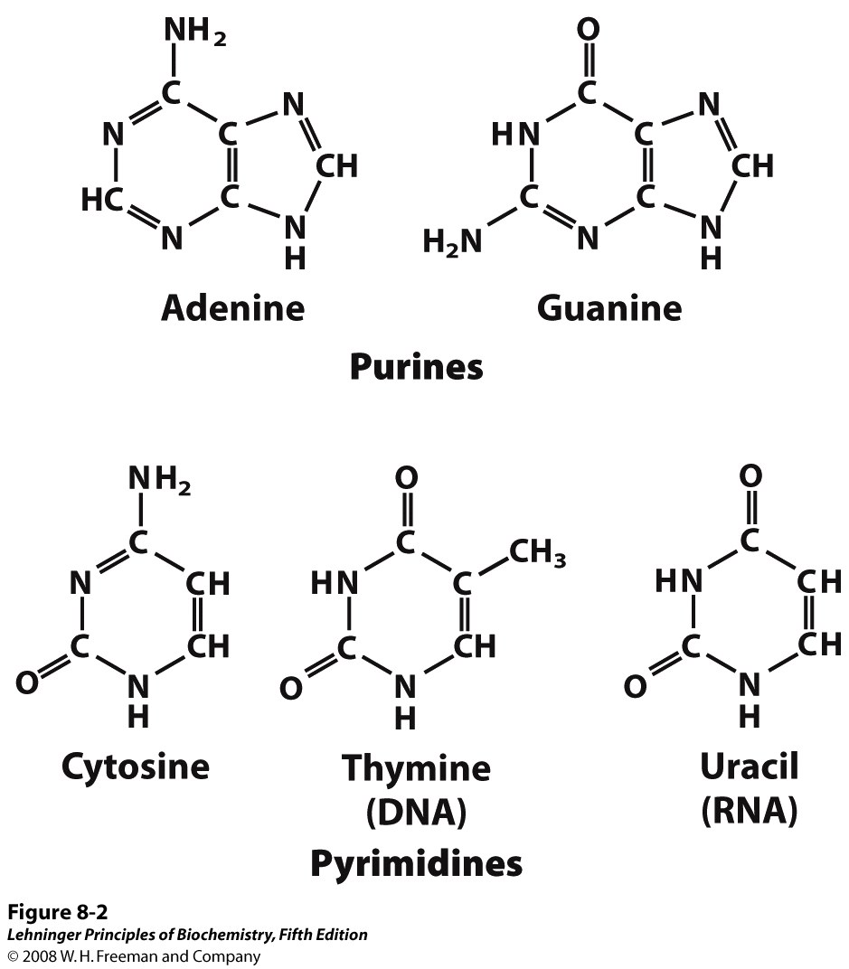
Purine and Pyrimidine Bases
Notes:
Major purine and pyrimidine bases. Adenine, guanine and cytosine are common to both DNA and RNA. It is important to note that Thymine is present in DNA whereas Uracil occurs in RNA.

Slide 20
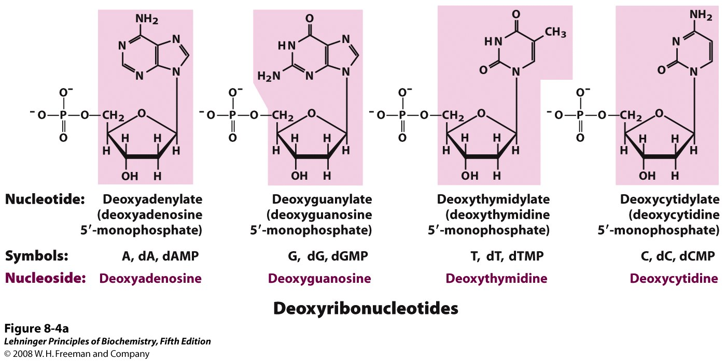
Nucleotide = Nucleoside + Phosphate
(Nucleoside = Sugar + Base)
Notes:
Deoxyribonucleotides and ribonucleotides of nucleic acids. All nucleotides are shown in their free form at pH 7.0. The nucleotide units of DNA (a) are usually symbolized as A, G, T, and C, sometimes as dA, dG, dT, and dC; those of RNA (b) as A, G, U, and C. In their free form the deoxyribonucleotides are commonly abbreviated dAMP, dGMP, dTMP, and dCMP; the ribonucleotides, AMP, GMP, UMP, and CMP. For each nucleotide, the more common name is followed by the complete name in parentheses. All abbreviations assume that the phosphate group is at the 5′ position. The nucleoside portion of each molecule is shaded in pink. In this and the following illustrations, the ring carbons are not shown.

Slide 21
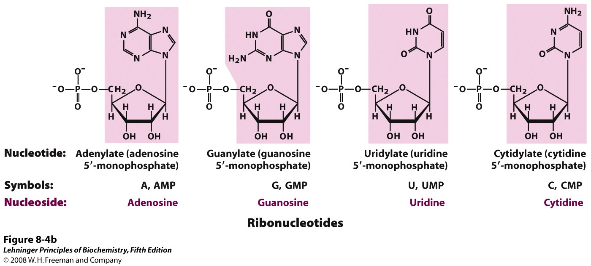
Nucleotide = Nucleoside + Phosphate
(Nucleoside = Sugar + Base)
Notes:
Deoxyribonucleotides and ribonucleotides of nucleic acids. All nucleotides are shown in their free form at pH 7.0. The nucleotide units of DNA (a) are usually symbolized as A, G, T, and C, sometimes as dA, dG, dT, and dC; those of RNA (b) as A, G, U, and C. In their free form the deoxyribonucleotides are commonly abbreviated dAMP, dGMP, dTMP, and dCMP; the ribonucleotides, AMP, GMP, UMP, and CMP. For each nucleotide, the more common name is followed by the complete name in parentheses. All abbreviations assume that the phosphate group is at the 5′ position. The nucleoside portion of each molecule is shaded in pink. In this and the following illustrations, the ring carbons are not shown.

Slide 22
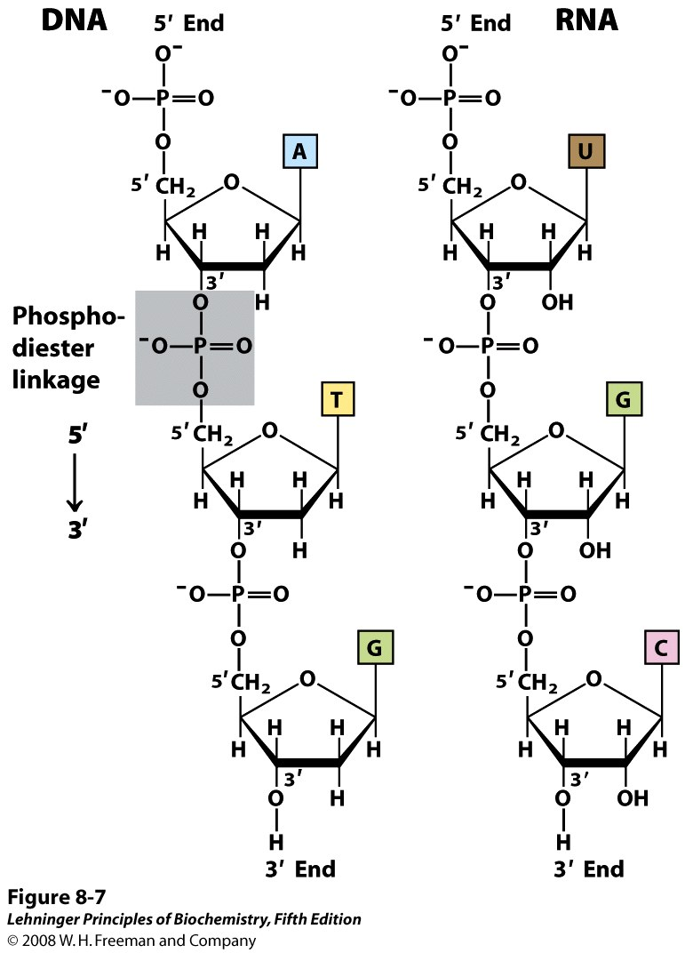
Phosphodiester Linkages in the Covalent Backbone of Nucleic Acid
Notes:
A single nucleotide chain contains a pentose-phosphate backbone. Individual pentose rings are connected through phospho-diester bonds. Each of these phospho-diester bonds connect the 3’- and 5’-OH groups. The chain has an end to end chemical orientation having 5’-phosphate at one terminal and 3’-OH at the other. Later in this class we will see that the DNA or RNA polymerase synthesizes the nucleic acid chains from 5’ to 3’ orientation. Hence the convention is to read the nucleic acid chain from 3’ to 5’ direction.

Slide 23
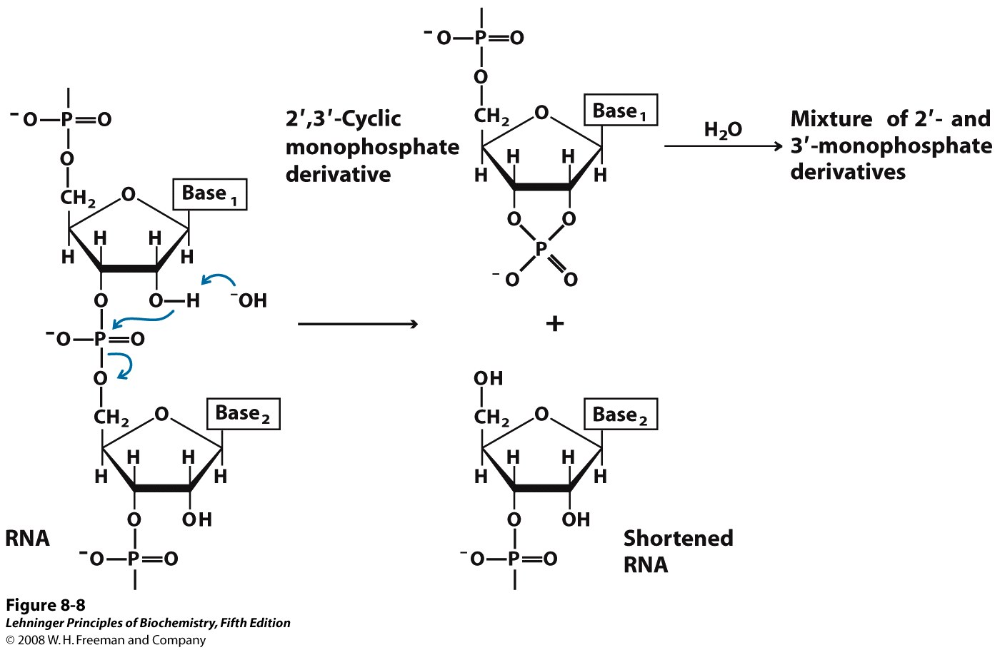
RNA is Less Stable than DNA
Notes:
Hydrolysis of RNA under alkaline conditions. The 2′ hydroxyl acts as a nucleophile in an intramolecular displacement. The 2′,3′-cyclic monophosphate derivative is further hydrolyzed to a mixture of 2′- and 3′-monophosphates. DNA, which lacks 2′ hydroxyls, is stable under similar conditions.
The more stable DNA is used to store genetic information whereas the less stable RNA is used as and intermediate copy for protein synthesis (See Central Dogma).

Slide 24
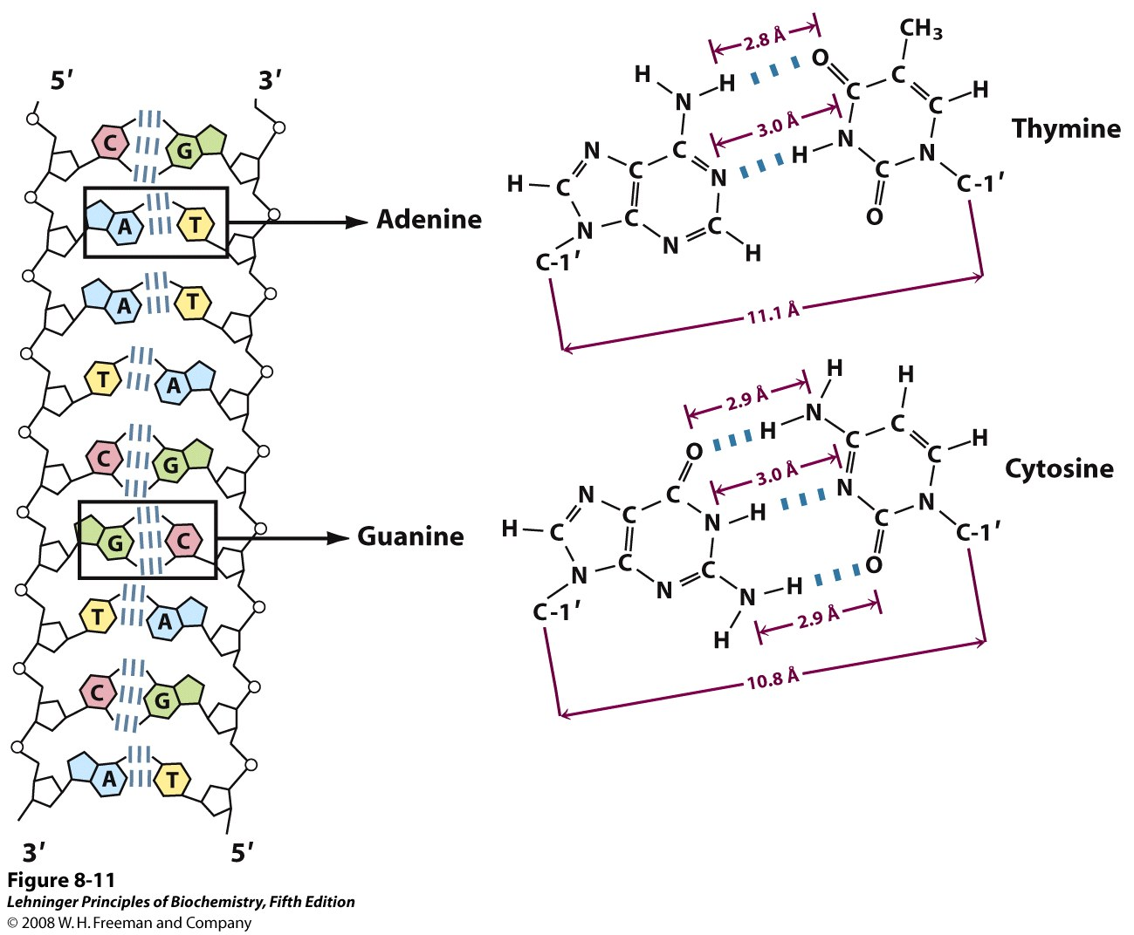
DNA: Deoxyribonucleic Acid
Notes:
In case of DNA two nucleic acid strands anneal together through extensive inter-strand H-bonding between the bases. This base pairing follows the rule proposed by Watson and Crick. A always pairs with T and G with C (Chargaff’s rule). Hence the two strands become complementary to each other. Directionality of two strands is opposite: one is 5’-3’ and another is 3’-5’. Hence complementary DNA strands are antiparallel. The base-paired antiparallel strands differ in base composition: the left strand has the composition A₃ T₂ G₁ C₃; the right, A₂ T₃ G₃ C₁.

Slide 25
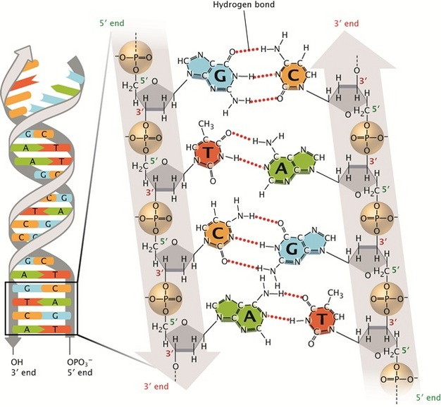
DNA: Deoxyribonucleic Acid
© 2013 Nature Education All rights reserved.

Slide 26
Some key features of DNA
In DNA, two nucleic acid strands anneal together through extensive inter-strand H-bonding between the bases. This base pairing follows the rule proposed by Watson and Crick.
Chargaff’s rule: A always pairs with T and G pairs with C
Hence the two strands become complementary to each other
Directionality of two strands is opposite: one is 5’-3’ and another is 3’-5’
Hence complementary DNA strands are antiparallel

Slide 27
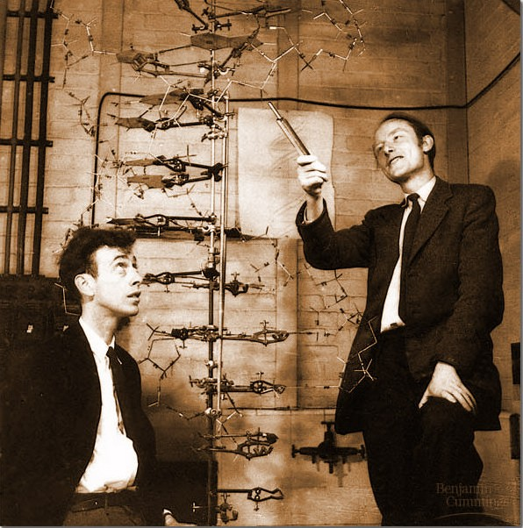
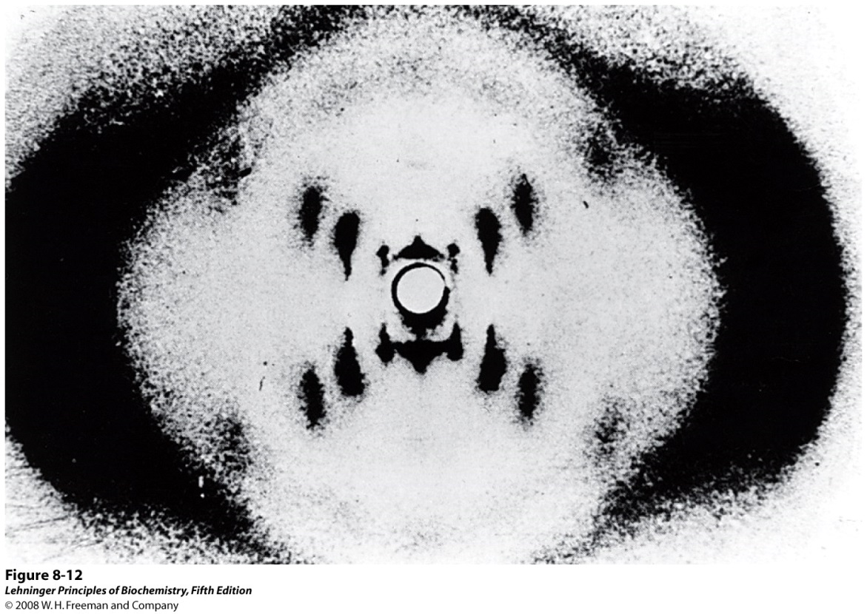
Discovery of the DNA Structure
Structure was discovered in 1953 by James Watson and Francis Crick
Awarded Nobel Prize in 1962
Rosalind Franklin
Notes:
DNA structure was discovered in 1953 by James Watson and Francis Crick based upon the x-ray diffraction data obtained by Rosalind Franklin and Maurice Wilkins. They proposed a double helix structure for double stranded DNA with A always hydrogen bonded to T and G with C.

Slide 28
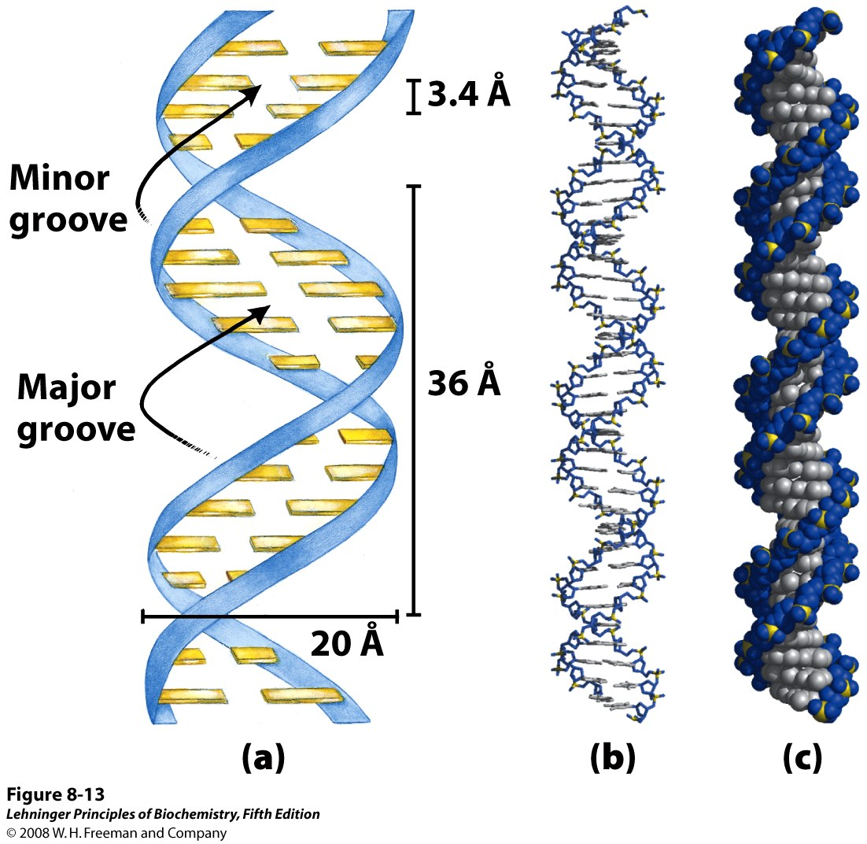
Watson-Crick Model for the Structure of DNA
a
b
c
Notes:
Watson-Crick model for the structure of DNA. In this structure, the pentose phosphate backbone of the DNA strands, which is significantly polar in nature remains outside and the bases which are hydrophobic pointed towards inside. The bases of the anti-parallel strands participates in H-bonding with each other. The original model proposed by Watson and Crick had 10 base pairs, or 34 Å (3.4 nm), per turn of the helix; subsequent measurements revealed 10.5 base pairs, or 36 Å (3.6 nm), per turn. (a) Schematic representation, showing dimensions of the helix. (b) Stick representation showing the backbone and stacking of the bases. (c) Space-filling model.
The spaces in between the interwind strands forms two helical grooves of different width as major and minor grooves. The bases are accessible to outside molecules, like water or DNA binding proteins and forms two different kinds of binding surfaces for them.

Slide 29
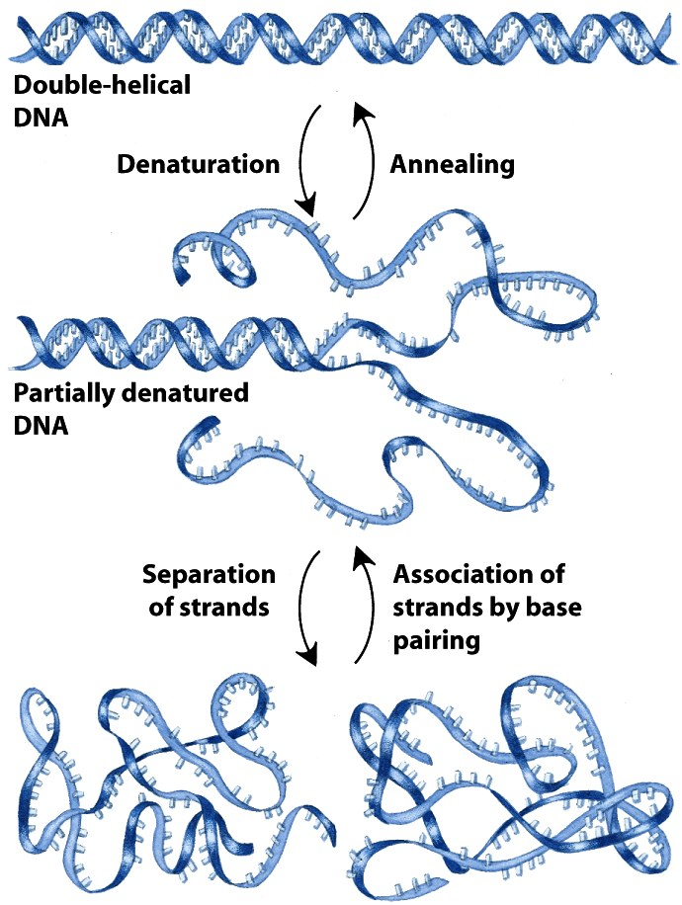
Reversible Denaturation and Annealing (Renaturation) of DNA
Notes:
Reversible denaturation and annealing (renaturation) of DNA.
Upon denaturation, the hydrophobic bases gets exposed to outside solvent hence becomes insoluble and precipitated out. That’s why if you denature DNA using heat or other chemical reagents it forms insoluble matter.
Double stranded DNA helix is the energetically favourable structure. That’s why, it takes energy to denature the DNA. Entropy decreases. Free energy increases. Non-spontaneous process.

Slide 30
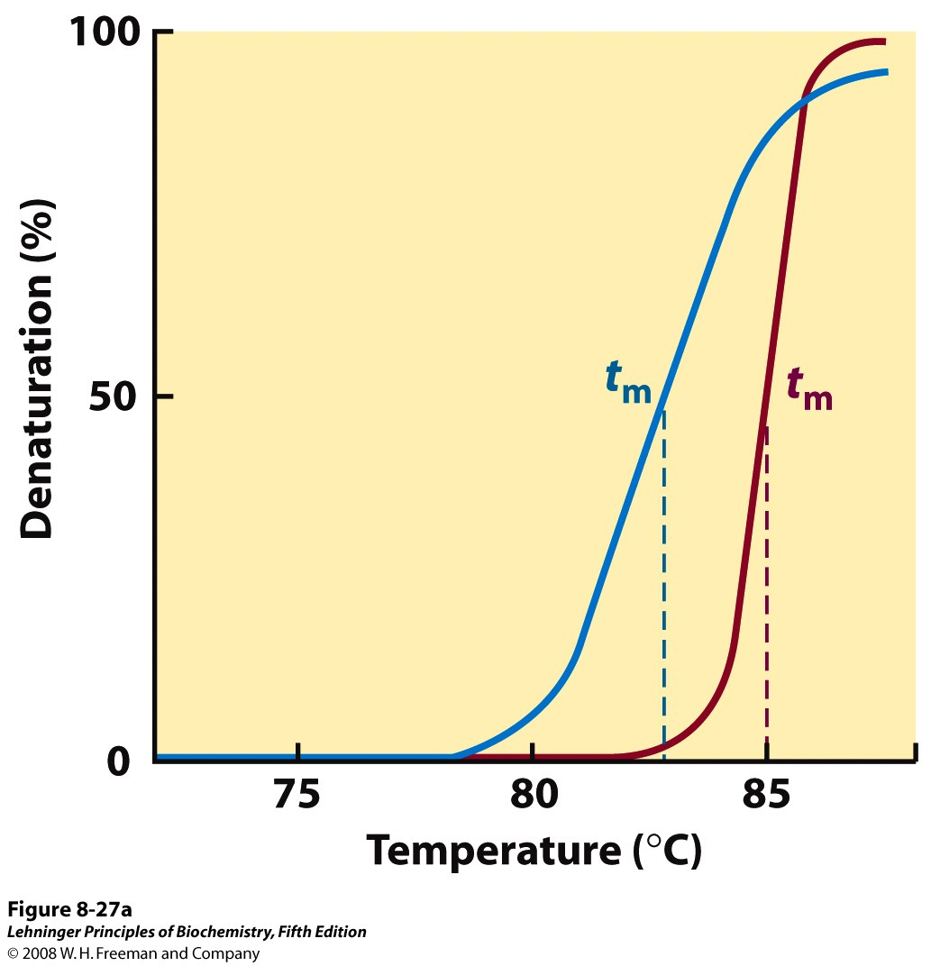
Heat Denaturation of DNA
Notes:
Heat denaturation of DNA. (a) The denaturation, or melting, curves of two DNA specimens. The temperature at the midpoint of the transition (t_{m}) is the melting point; it depends on pH and ionic strength and on the size and base composition of the DNA.
G-C base pair has three hydrogen bonds while A-T base pair has two hydrogen bonds. Hence, DNA sequences with higher G-C content are relatively tightly held together and have higher melting point.

